Slide 1
How do Scientists Communicate?
Take 3 minutes to come up with a list of as many different ways that a scientist might use to share their findings with other scientists and with the the public

Slide 2
Scientists often use visual representations of their data to tell stories about their research
Let’s look at one example taken from social scientists, who study how groups of people behave…

Slide 3
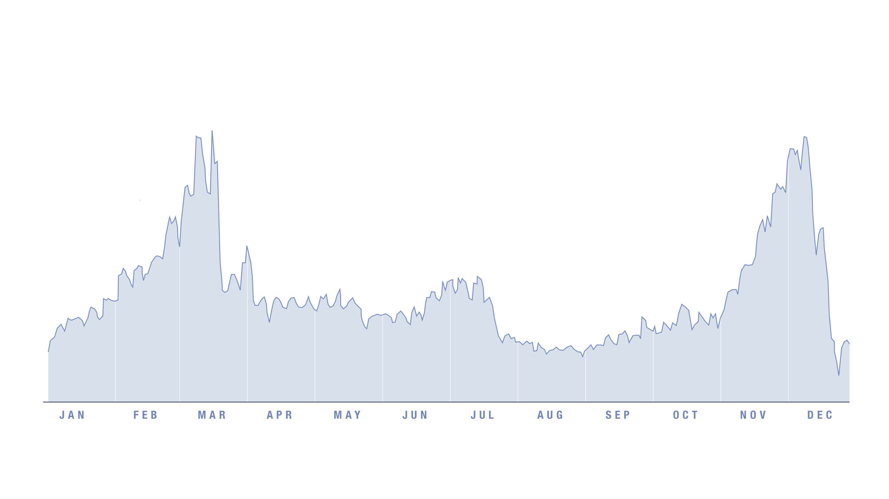
Notes:
Use David MacCandless’s TED talk (http://www.ted.com/talks/david_mccandless_the_beauty_of_data_visualization.html ) at time. He first has the audience guess what this is, noting some of the patterns. So allow the students to guess what this is and point out anything they notice. MacCandless points out: “What rises twice a year? Once in Easter and then two weeks before christmas, has a mini peak every Monday and then flattens out over the summer?”
Allow for time to think about what it might be.

Slide 4
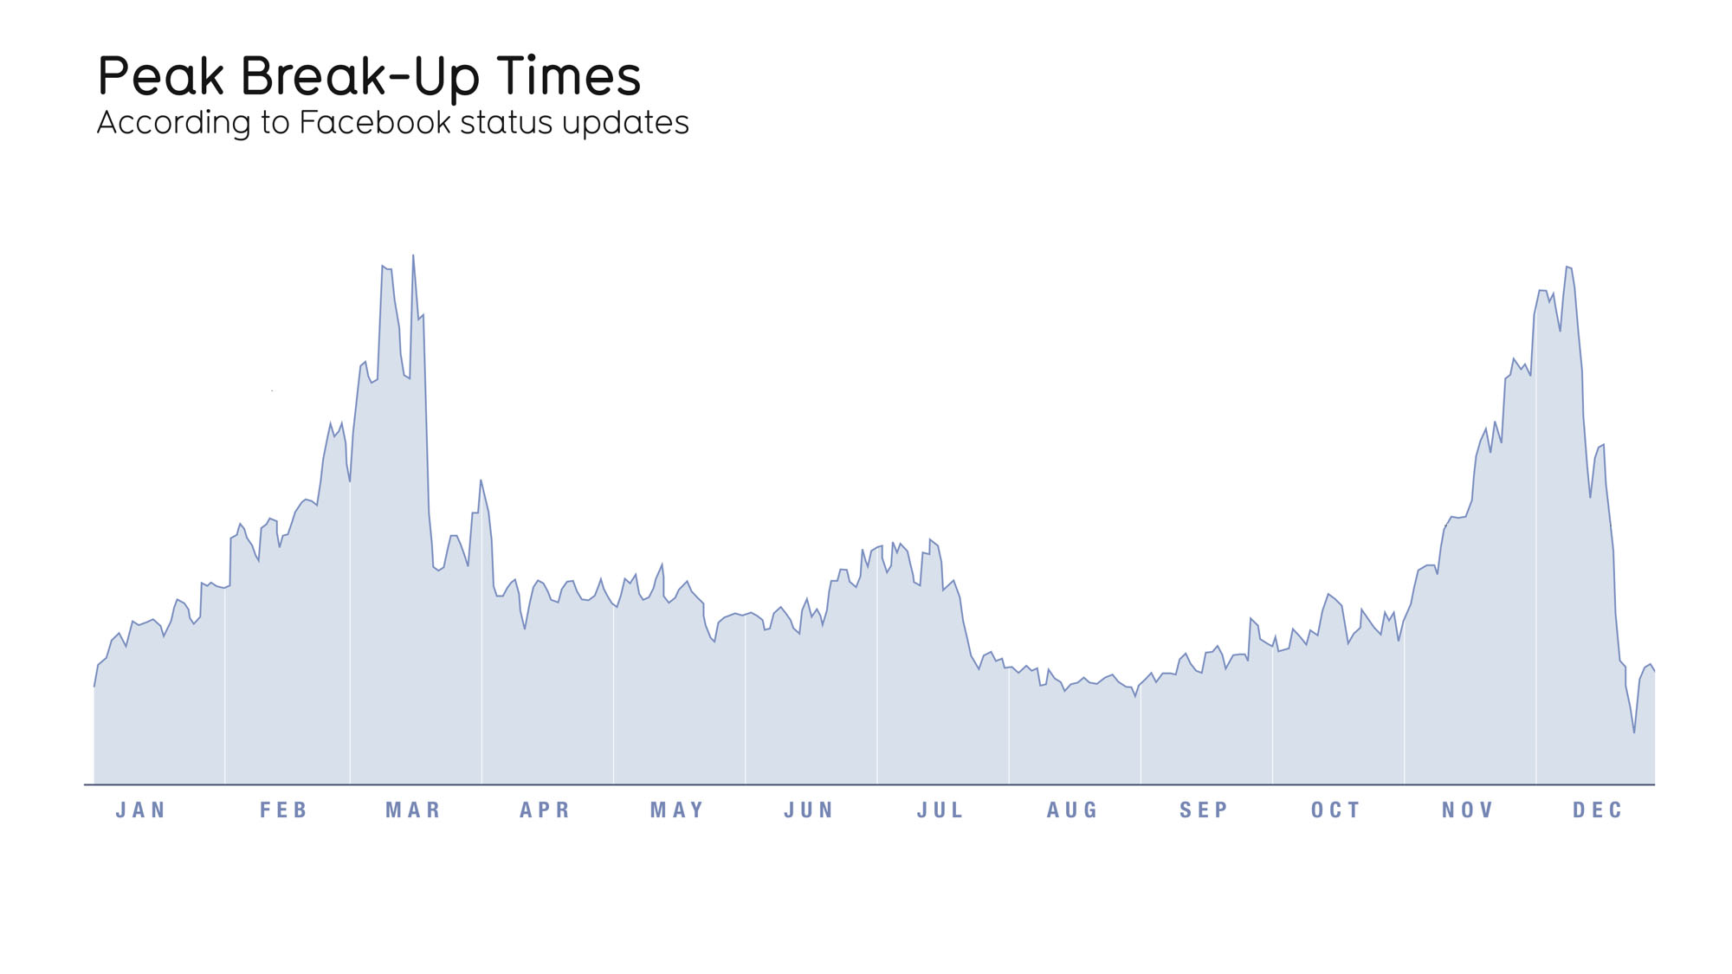
Notes:
Only reveal the title of the graphic once students have brainstormed for a while.

Slide 5
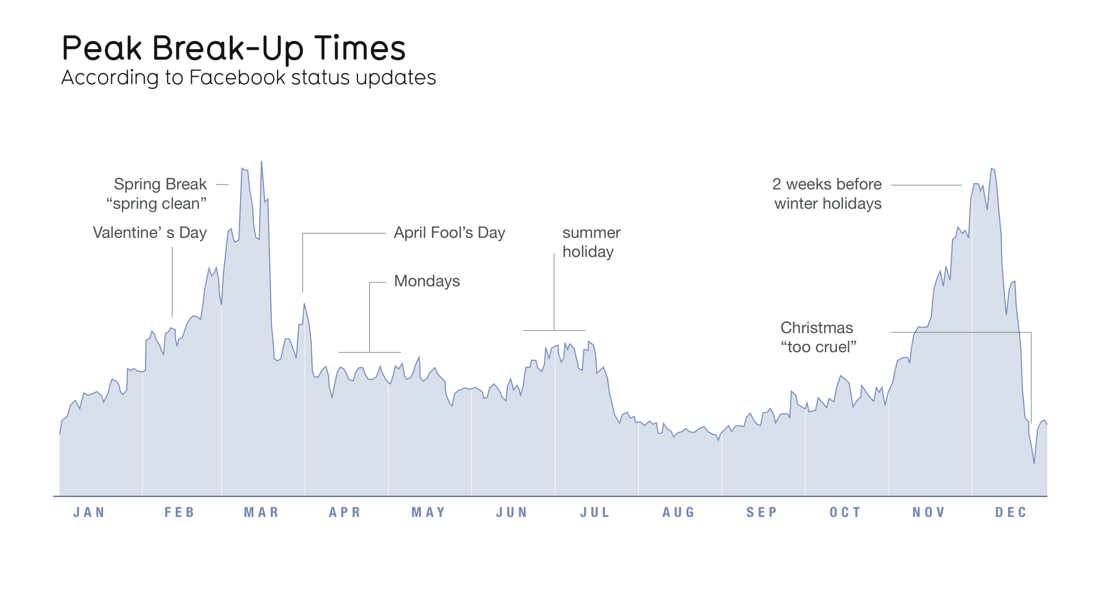
Source: searches for “we broke up because”
from Facebook Lexicon
Notes:
At this point you can ask what the numbers actually represent. This graphic actually does a terrible job of telling us specific numbers. You can even use they same question they will see in the worksheet: “Pick one point on the image that represents a number. What is that number (you can approximate, if necessary) and what are the units? If known, what is the source of the data?” In this case, the source of the data is given, but not the actually units of numbers. In the presentation it says they looked through 10,000 facebook status updates. The other question to ask is another from the 1st worksheet: “Describe how the author represents data in the graphic? (Ex. Using color to differentiate two things.) “ Here the answers can include a line graph over time; labels of interesting patterns; height of the area under the line; etc.

